Slide 1


BACHELOR OF TECHNOLOGY
IN
Artificial Intelligence and Machine Learning
Handwritten Analysis and Recognition based on multi-class pair-wise support vector machine
Batch Number: 19
Project Guide Batch Names & Roll Numbers
Dr. Sujit Das Keesara Bhanu Prakash Reddy 2011CS020165
Kannegandla Jathin Gupta 2011CS020166
Kankanala Rishivardhan Reddy 2011CS020167
Koppineedi Satvik Sai Praneeth 2011CS020168
Department of AIML, School of Engineering
Malla Reddy University

Slide 2
BACHELOR OF TECHNOLOGY
IN
Artificial Intelligence and Machine Learning
Batch Number: 13
Project Guide Batch Names & Roll Numbers
Prof. VINAY SIMHA Y.CHOLAVI - 2011CS020231
M.SRINATH - 2011CS020232
M.SRINITHISH - 2011CS020233
M.SUMA - 2011CS020234
Department of AIML, School of Engineering
Malla Reddy University
CONTENTS

Slide 3
Problem Statement
Introduction
Literature Survey
Research Gap
Results and Discussions
Algorithms/Flow Charts
Observations
BACHELOR OF TECHNOLOGY
IN
Artificial Intelligence and Machine Learning
Handwritten Analysis and Recognition based on multi-class pair-wise support vector machine
Batch Number: 19
Project Guide Batch Names & Roll Numbers
Dr. Sujit Das Keesara Bhanu Prakash Reddy 2011CS020165
Kannegandla Jathin Gupta 2011CS020166
Kankanala Rishivardhan Reddy 2011CS020167
Koppineedi Satvik Sai Praneeth 2011CS020168
Department of AIML, School of Engineering
Malla Reddy University
Problem Statement
Abstract
Introduction
Literature Survey
Existing System
CONTENTS
Proposed System
Architecture
Results and Discussions
Conclusion

Slide 4
Problem Statement
Abstract
Introduction
Crop yield prediction is an important agricultural problem. Predicting crop yield is not an easy task ,the Agricultural yield primarily depends on weather conditions (rain, temperature, etc), pesticides.
The main concept is to increase the throughput of the agriculture sector with the Deep Learning models.
CONTENTS
Literature Survey
Existing System
Proposed System
Architecture
Results and Discussions
Conclusion

Slide 5
Problem Statement
Handwritten analysis and recognition is an important task in image processing and pattern recognition. It has numerous applications in areas such as postal automation, bank check processing, and signature verification. Traditional SVM models have been used for handwritten recognition, but they may not perform well in cases where the number of classes is large or the classes are highly imbalanced. MPSVM is a variant of SVM that can overcome these limitations and provide better performance.
Abstract
The accurate prediction of vehicular traffic flow remains a challenging task, as traditional models fail to capture the intricate temporal dependencies and non-linear dynamics present in traffic data.
Introduction
Literature Survey
Existing System
Proposed System
CONTENTS
Architecture
Results and Discussions
Conclusion

Slide 6
Problem Statement
Abstract
Vehicular traffic flow prediction is a crucial task for transportation management and planning.
This research aims to develop a robust traffic flow prediction model using LSTM neural networks .
While traditional models use shallow networks, there has been an exponential growth in the number of vehicles in recent times and these traditional machine learning models fail to work in current scenarios.
Accurate predictions help optimize traffic management, improve road safety, and enhance overall traffic efficiency.
Several studies have been conducted on handwritten recognition using SVM models. Some studies have focused on improving the feature extraction techniques, while others have focused on optimizing the hyperparameters of the SVM model. A few studies have also explored the use of alternative machine learning algorithms, such as neural networks and decision trees. However, few studies have investigated the use of MPSVM for handwritten recognition, and its performance has not been thoroughly evaluated.
Crop yield prediction is an important agricultural problem. Predicting crop yield is not an easy task ,the Agricultural yield primarily depends on weather conditions (rain, temperature, etc), pesticides.
The main concept is to increase the throughput of the agriculture sector with the Deep Learning models
Introduction
Literature Survey
Existing System
Proposed System
Architecture
Results and Discussions
Conclusion

Slide 7
Problem Statement
Abstract
Introduction
Agriculture plays a critical role in the global economy. With the continuing expansion of the human population understanding worldwide crop yield is central to addressing food security challenges and reducing the impacts of climate change.
The central idea of this is to make the farmers aware of climatic conditions and also about the types of crops to be cultivated during that season.
Accurate information about history of crop yield is important for making decisions related to agricultural risk management and future predictions based on Deep learning techniques.
Literature Survey
Vehicular traffic flow prediction is of significant importance in intelligent transportation systems, aiming to optimize traffic management, enhance road safety, and improve overall traffic efficiency.
Traditional models often struggle to capture the temporal dependencies and long-term trends inherent in traffic data. To overcome these limitations, this research proposes a robust prediction model utilizing LSTM neural networks.
By leveraging historical traffic flow information, the proposed model aims to provide more precise predictions, thereby enabling better traffic management strategies and informed decision-making for transportation authorities and stakeholders.
Handwritten analysis and recognition is an important task in image processing and pattern recognition. It has numerous applications in areas such as postal automation, bank check processing, and signature verification. Traditional SVM models have been used for handwritten recognition, but they may not perform well in cases where the number of classes is large or the classes are highly imbalanced. MPSVM is a variant of SVM that can overcome these limitations and provide better performance.
Proposed System
Existing System
Architecture
Results and Discussions
Conclusion

Slide 8
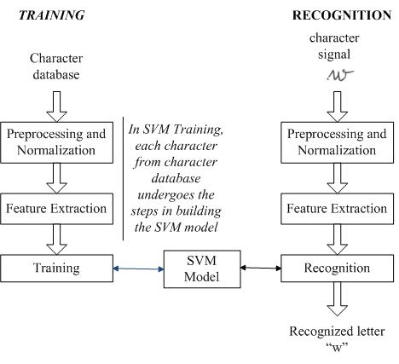
Problem Statement
Abstract
Introduction
Literature Survey
Several studies have been conducted on handwritten recognition using SVM models. Some studies have focused on improving the feature extraction techniques, while others have focused on optimizing the hyperparameters of the SVM model. A few studies have also explored the use of alternative machine learning algorithms, such as neural networks and decision trees. However, few studies have investigated the use of MPSVM for handwritten recognition, and its performance has not been thoroughly evaluated.
Learning traffic as images: A deep convolutional neural network for large-scale transportation network speed prediction by Zhang, J., Zheng, Y., Qi, D., Liu, K., & Bai, Y. (2020).
Hybrid attentional recurrent neural networks for short-term traffic flow prediction by Zhang, X., Chen, T., Zhao, Z., Cao, B., & Huang, Q. (2021).
Existing System
Proposed System
Architecture
Results and Discussions
Conclusion

Slide 9
Problem Statement
Abstract
Introduction
Literature Survey
Existing System
The research gap in this study is to evaluate the performance of MPSVM for handwritten recognition and compare it to traditional SVM models. This study aims to fill this gap by developing an MPSVM-based system for handwritten recognition and evaluating its performance on a standard dataset.
Proposed System
The existing traffic flow prediction systems are mostly based on traditional statistical methods, such as time-series analysis, regression, and autoregressive models.
These models have limited accuracy in predicting traffic flow, especially during peak hours and under dynamic traffic conditions.
These models often fail to capture the complex relationships between traffic flow and external factors such as weather conditions, accidents, and road construction.
Architecture
Results and Discussions
Conclusion

Slide 10
Problem Statement
Abstract
Introduction
Literature Survey
Proposed System
The research gap in this study is to evaluate the performance of MPSVM for handwritten recognition and compare it to traditional SVM models. This study aims to fill this gap by developing an MPSVM-based system for handwritten recognition and evaluating its performance on a standard dataset.
Architecture
The proposed methodology involves the development of a vehicular traffic flow prediction model using LSTM networks in deep learning.
The first step is data preprocessing, which includes collecting historical traffic flow data and performing necessary data cleaning and normalization.
The LSTM architecture is then designed, comprising input layers, LSTM layers, and output layers.To evaluate the model's performance, a portion of the dataset is reserved for validation and testing.
Finally, the trained LSTM model is utilized to predict future traffic flow by feeding it with sequential input data
Results and Discussions
Conclusion

Slide 11
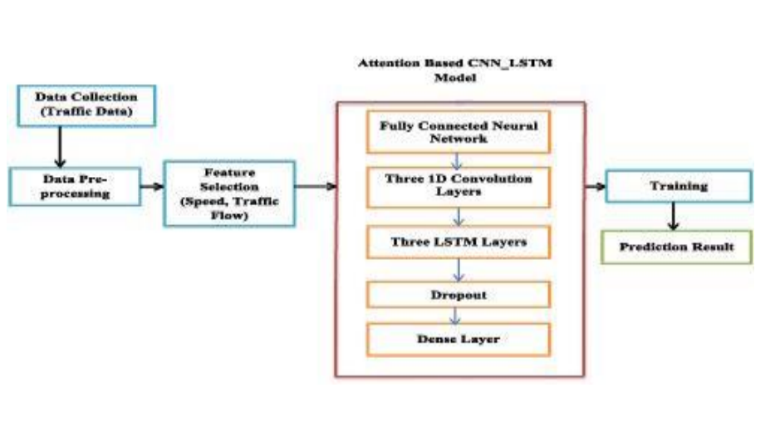
Problem Statement
Introduction
Literature Survey
Abstract
Proposed System
Architecture
The observations of this study will include the performance of the MPSVM-based system for handwritten recognition in comparison to traditional SVM models. The performance metrics that will be used include accuracy, precision, recall, and F1-score. The study will also evaluate the impact of different feature extraction techniques and hyperparameters on the performance of the MPSVM model. The observations of this study will provide insights into the effectiveness of MPSVM for handwritten recognition and its potential applications in real-world scenarios.
Results and Discussions
Conclusion

Slide 12
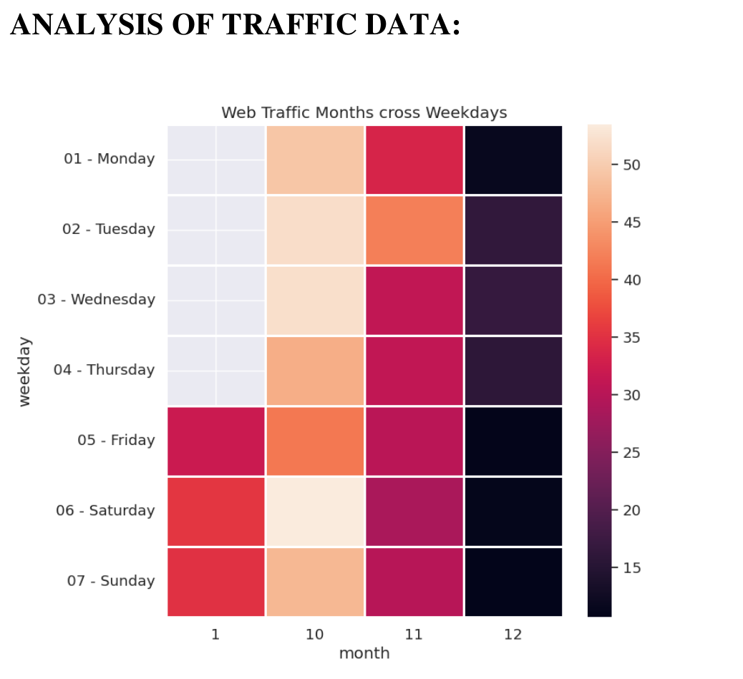
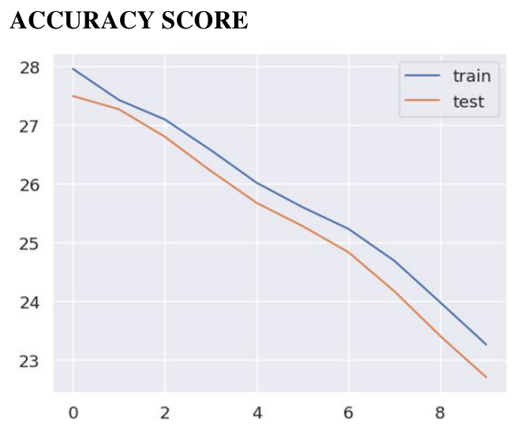
Problem Statement
Introduction
Literature Survey
Abstract
Proposed System
Architecture
Results and Discussions
The observations of this study will include the performance of the MPSVM-based system for handwritten recognition in comparison to traditional SVM models. The performance metrics that will be used include accuracy, precision, recall, and F1-score. The study will also evaluate the impact of different feature extraction techniques and hyperparameters on the performance of the MPSVM model. The observations of this study will provide insights into the effectiveness of MPSVM for handwritten recognition and its potential applications in real-world scenarios.
Conclusion

Slide 13
Problem Statement
Literature Survey
Introduction
Research Gap
Block Diagram/ Architecture
Results and Discussions
Conclusion
THANK YOU
In conclusion, the vehicular traffic flow prediction model utilizing LSTM in deep learning has shown great potential in accurately forecasting traffic conditions.
The LSTM-based approach effectively captures the complex temporal dependencies and long-term patterns inherent in traffic flow data, resulting in improved prediction accuracy compared to traditional models.
Overall, the LSTM-based traffic flow prediction model presents a valuable contribution to intelligent transportation systems and has the potential to revolutionize the way traffic is managed and controlled.

Slide 14
Introduction
Problem Statement
Literature Survey
Research Gap
Block Diagram/ Architecture
Algorithms/Flow Charts
Observations
The observations of this study will include the performance of the MPSVM-based system for handwritten recognition in comparison to traditional SVM models. The performance metrics that will be used include accuracy, precision, recall, and F1-score. The study will also evaluate the impact of different feature extraction techniques and hyperparameters on the performance of the MPSVM model. The observations of this study will provide insights into the effectiveness of MPSVM for handwritten recognition and its potential applications in real-world scenarios.
THANK YOU

